Slide 1

Exploring
#3 HTTP Module

Slide 2
Clients & Servers
Request
C L I E N T
S E R V E R
Response
When we surf in a website sometimes we do something, for instance click a button, it will request data from the server & we’ll see its response, like opening a new webpage.
Client & server communicate each other, using protocols: a set of communication rules, that both client & server agree to use when communicating.

Slide 3
HTTP Methods
HTTP (The Hypertext Transfer Protocol) is designed to enable communications between clients & servers. It works as a request & response protocol between a client & server.
A web browser may be the client, and an application on a computer that hosts a web site may be the server.
The most commonly used HTTP Methods are POST, GET, PUT, PATCH & DELETE.

Slide 4
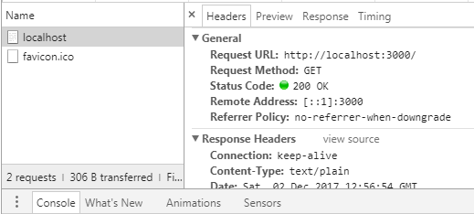
Create a Server
var http = require('http');
var server = http.createServer(function(req,res){
res.writeHead(200, {'Content-Type' : 'text/plain'});
res.end('Halo semuanya!');
});
server.listen(3000);
// buka di browser = localhost : 3000
console.log('Server aktif. Listening port 3000.');

Slide 5
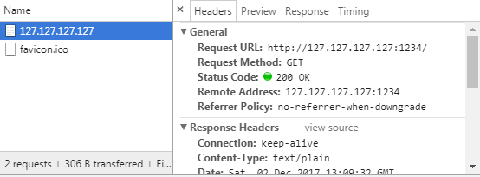
Create a Server
# set url
var http = require('http');
var server = http.createServer(function(req,res){
res.writeHead(200, {'Content-Type' : 'text/plain'});
res.end('Halo semuanya!');
});
server.listen(1234, '127.127.127.127');
// buka di browser = 127.127.127.127 : 1234
console.log('Server aktif. Listening port 1234.');

Slide 6
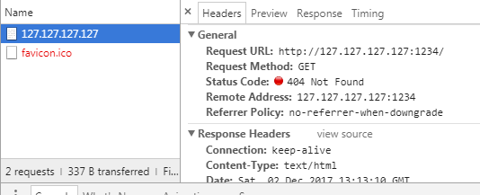
Create a Server
# set response
var http = require('http');
var server = http.createServer(function(req,res){
res.writeHead(404, {'Content-Type' : 'text/html'});
res.end('<h1>Halo semuanya!</h1>');
});
server.listen(1234, '127.127.127.127');
// buka di browser = 127.127.127.127 : 1234
console.log('Server aktif. Listening port 1234.');

Slide 7
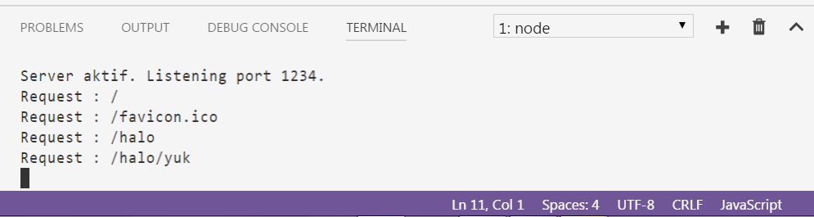
Create a Server
# print request url
var http = require('http');
var server = http.createServer(function(req,res){
console.log('Request : ' + req.url);
res.writeHead(404, {'Content-Type' : 'text/html'});
res.end('<h1>Halo semuanya!</h1>');
});
server.listen(1234, '127.127.127.127');
console.log('Server aktif. Listening port 1234.');
// buka di browser, tambahkan url target /sesuatu

Slide 8
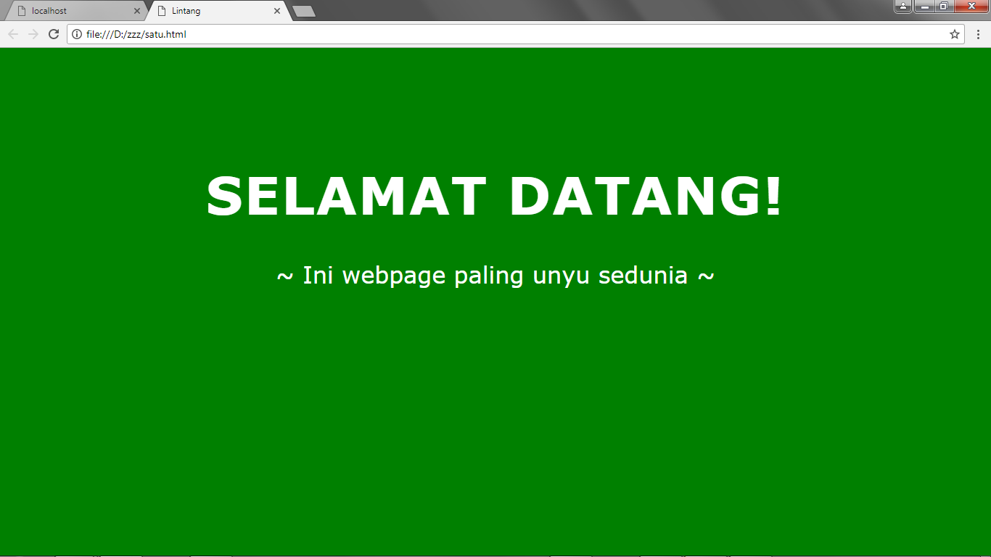
Serving HTML File
satu.html

Slide 9
Serving HTML File
satu.html
<!DOCTYPE html>
<html>
<head><title>Lintang</title>
<style>
body{background:green; font-family:verdana; color:white; padding:150px;}
h1{font-size:72px; text-transform:uppercase; letter-spacing:2px; text-align:center;}
p{font-size:32px; text-align:center;}
</style>
</head>
<body>
<h1>Selamat Datang!</h1>
<p>~ Ini webpage paling unyu sedunia ~</p>
</body>
</html>

Slide 10
Serving HTML File
#1 using FS readFileSync
satu.js
var http = require('http');
var fs = require('fs');
var x = fs.readFileSync('satu.html', 'utf8');
var server = http.createServer(function(req,res){
console.log('Request : ' + req.url);
res.writeHead(200, {'Content-Type':'text/html'});
res.end(x);
});
server.listen(3000);
console.log('Server aktif. Listening port 3000.');

Slide 11
Serving HTML File
#2 using FS readStream
satu.js
var http = require('http');
var fs = require('fs');
var server = http.createServer(function(req,res){
console.log('Request : ' + req.url);
res.writeHead(200, {'Content-Type':'text/html'});
var bacaStream =fs.createReadStream(__dirname+'/satu.html','utf8');
bacaStream.pipe(res);
});
server.listen(3000);
console.log('Server aktif. Listening port 3000.');

Slide 12
J S O N
JSON (Javascript Object Notation) is a lightweight data-interchange format that based on a subset of JS. It’s easy to read, write and can be used with any modern language.
JSON is not a JavaScript Object!
JSON rules:
Uses property/value pairs = {"nama" : "Andi"}
Uses doublequotes on its prop & val (except number)
Must use specified data type
File type is ".json"
Mime type is "application/json"

Slide 13
satu.js
var http = require('http');
var fs = require('fs');
var server = http.createServer(function(req,res){
console.log('Request : ' + req.url);
res.writeHead(200, {'Content-Type':'application/json'});
var dataku = {
nama: 'Lintang',
usia: 24,
jomblo: true
};
res.end(JSON.stringify(dataku));
});
server.listen(3000);
console.log('Server aktif. Listening port 3000.');
Serving JSON Data

Slide 14
Serving JSON File #1
satu.json
{
"nama":"Lintang",
"usia": 24,
"status": "jomblo"
}

Slide 15
Serving JSON File #2
satu.js
var http = require('http');
var fs = require('fs');
var x = fs.readFileSync('satu.json', 'utf8');
var server = http.createServer(function(req,res){
console.log('Request : ' + req.url);
res.writeHead(200, {'Content-Type':'text/plain'});
res.end(x);
});
server.listen(3000);
console.log('Server aktif. Listening port 3000.');

Slide 16

Routing
/beranda
/profil
/berita
/galeri
/tentang
/kontak

Slide 17
home.js
var http = require('http');
var fs = require('fs');
var server = http.createServer(function(req,res){
console.log('Request : ' + req.url);
if(req.url === '/home' || req.url === '/'){
res.writeHead(200, {'Content-Type':'text/html'});
fs.createReadStream(__dirname+'/home.html').pipe(res);
}
});
server.listen(3000);
console.log('Server aktif, port 3000.');
Basic Routing
#1 Home Page
* Buat home.html
* Dengan cara serupa, dapat dibuat route lainnya!

Slide 18
home.js
var http = require('http');
var fs = require('fs');
var server = http.createServer(function(req,res){
console.log('Request : ' + req.url);
if(req.url === '/home' || req.url === '/'){
res.writeHead(200, {'Content-Type':'text/html'});
fs.createReadStream(__dirname+'/home.html').pipe(res);
} else {
res.writeHead(404, {'Content-Type':'text/html'});
fs.createReadStream(__dirname+'/404.html').pipe(res);
}
});
server.listen(3000);
console.log('Server aktif, port 3000.');
Basic Routing
#2 Error 404 Not Found
* Buat home.html & 404.html
* Dengan cara serupa, dapat dibuat route lainnya!

Slide 19
HTTP Methods
var http = require('http');
console.log(http.METHODS);
[ 'ACL',
'BIND',
'CHECKOUT',
'CONNECT',
'COPY',
'DELETE',
'GET',
'HEAD',
'LINK',
'LOCK',
'M-SEARCH',
'MERGE',
'MKACTIVITY',
'MKCALENDAR',
'MKCOL',
'MOVE',
'NOTIFY',
'OPTIONS',
'PATCH',
'POST',
'PROPFIND',
'PROPPATCH',
'PURGE',
'PUT',
'REBIND',
'REPORT',
'SEARCH',
'SUBSCRIBE',
'TRACE',
'UNBIND',
'UNLINK',
'UNLOCK',
'UNSUBSCRIBE'
]

Slide 20
Status
Codes
var http = require('http');
console.log(http.STATUS_CODES);
{ '100': 'Continue',
'101': 'Switching Protocols',
'102': 'Processing',
'200': 'OK',
'201': 'Created',
'202': 'Accepted',
'203': 'Non-Authoritative Information',
'204': 'No Content',
'205': 'Reset Content',
'206': 'Partial Content',
'207': 'Multi-Status',
'208': 'Already Reported',
'226': 'IM Used',
'300': 'Multiple Choices',
'301': 'Moved Permanently',
'302': 'Found',
'303': 'See Other',
'304': 'Not Modified',
'305': 'Use Proxy',
'307': 'Temporary Redirect',
'308': 'Permanent Redirect',
'400': 'Bad Request',
'401': 'Unauthorized',
'402': 'Payment Required',
'403': 'Forbidden',
'404': 'Not Found',
'405': 'Method Not Allowed',
'406': 'Not Acceptable',
'407': 'Proxy Authentication Required',
'408': 'Request Timeout',
'409': 'Conflict',
'410': 'Gone',
'411': 'Length Required',
'412': 'Precondition Failed',
'413': 'Payload Too Large',
'414': 'URI Too Long',
'415': 'Unsupported Media Type',
'416': 'Range Not Satisfiable',
'417': 'Expectation Failed',
'418': 'I\'m a teapot',
'421': 'Misdirected Request',
'422': 'Unprocessable Entity',
'423': 'Locked',
'424': 'Failed Dependency',
'425': 'Unordered Collection',
'426': 'Upgrade Required',
'428': 'Precondition Required',
'429': 'Too Many Requests',
'431': 'Request Header Fields Too Large',
'451': 'Unavailable For Legal Reasons',
'500': 'Internal Server Error',
'501': 'Not Implemented',
'502': 'Bad Gateway',
'503': 'Service Unavailable',
'504': 'Gateway Timeout',
'505': 'HTTP Version Not Supported',
'506': 'Variant Also Negotiates',
'507': 'Insufficient Storage',
'508': 'Loop Detected',
'509': 'Bandwidth Limit Exceeded',
'510': 'Not Extended',
'511': 'Network Authentication Required' }

Slide 21
Allow Access
var http = require('http');
var server = http.createServer(function(req,res){
console.log('Request : ' + req.url);
res.writeHead(200, {
'Content-Type':'text/plain',
'Access-Control-Allow-Origin':'*'
});
var data = {'nama':'Lintang'};
res.end(JSON.stringify(data));
});
server.listen(3000, ()=>{
console.log('Server aktif di port 3000.');
});
* Cobalah GET dari React!

Slide 22
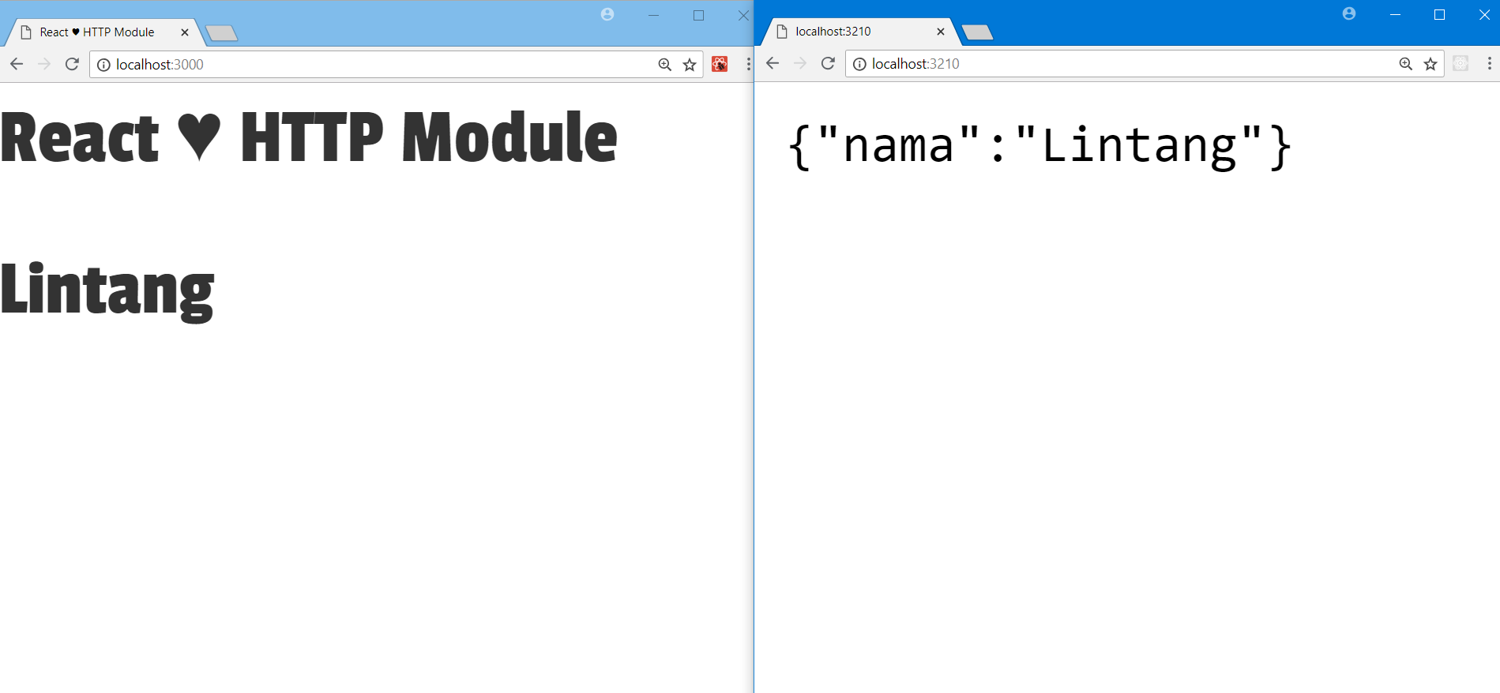
Allow Access
Front End
Back End

Slide 23
Exploring
#3 HTTP Module

